Slide 1
Localization

Slide 2
Review

Slide 3
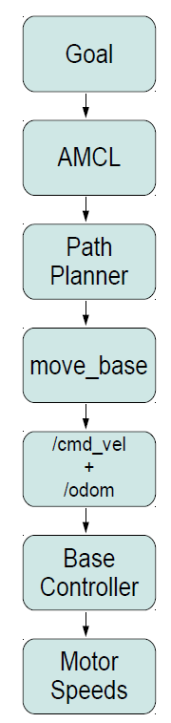
Motion Control
There is a hierarchy of motion controllers in ROS ranging from high-level semantic control to path planning to simple base controllers
The base controller node subscribes to the /cmd_vel topic and translates Twist messages into motor signals that actually turn the wheels.

Slide 4
Motion Message and Topics
geometry_msgs/Twist:
geometry_msgs/Vector3 linear
float64 x
float64 y
float64 z
geometry_msgs/Vector3 angular
float64 x
float64 y
float64 z
Topics:
/cmd_vel
/cmd_vel_mux
/cmd_vel_mux/input/teleop

Slide 5
Occupancy Grid Mapping
A family of computer algorithms for mobile robots which address the problem of generating maps from noisy and uncertain sensor data, assuming that the robot pose is known
The map is represented as an evenly-spaced grid of binary (occupied or unoccupied) random variables. Gmapping computes the probability estimates for individual cells from the robot’s odometry and laser scans.

Slide 6

Rao-Blackwellized Particle Filter (RBPF)
gmapping paper

Slide 7
Gmapping Algorithm
1. {x^{i}_{t}} is estimated from the previous {x^{i}_{t-1}} and odometry u_{t-1}
2. A scan-matching algorithm (e.g. VASCO) attempts to match the laser scan to the map m^{i}_{t-1} for a set of sampling points around x^{i}_{t}, resulting in a probability distribution for each x^{i}_{t}
3. New x^{i}_{t} are computed from the Gaussian approximation of the scan-matching probability distributions
4. The maps {m^{i}_{t-1}} are updated based on the new x^{i}_{t}

Slide 8
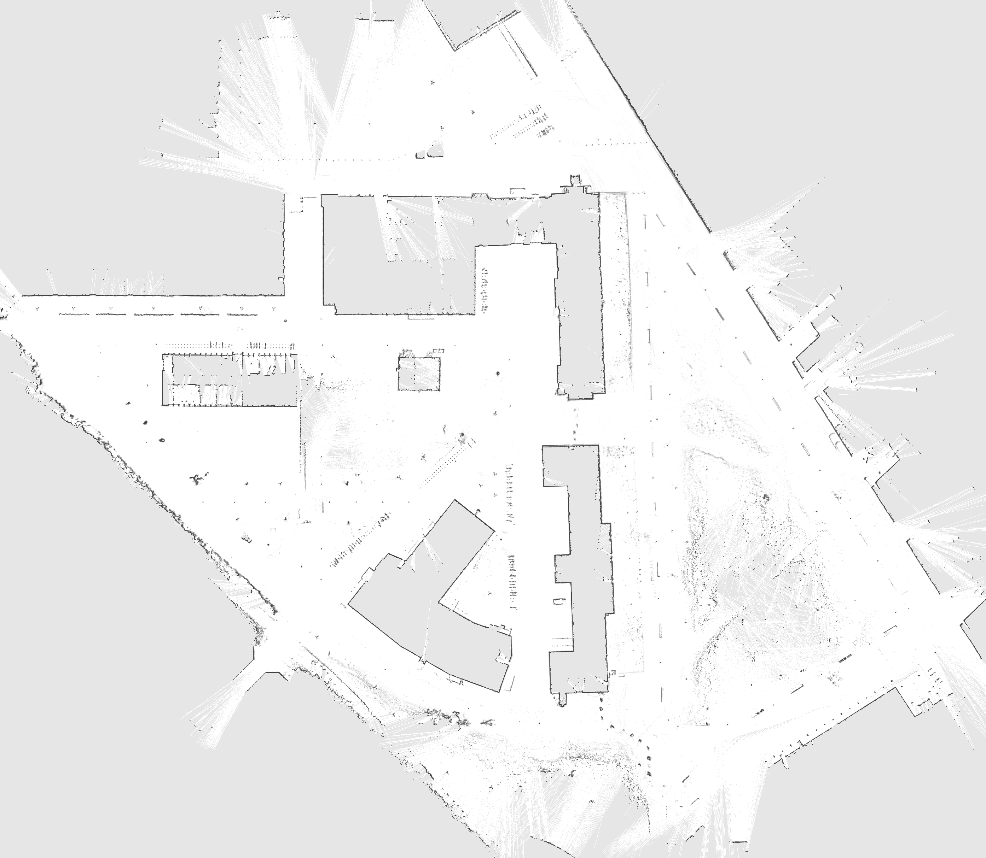
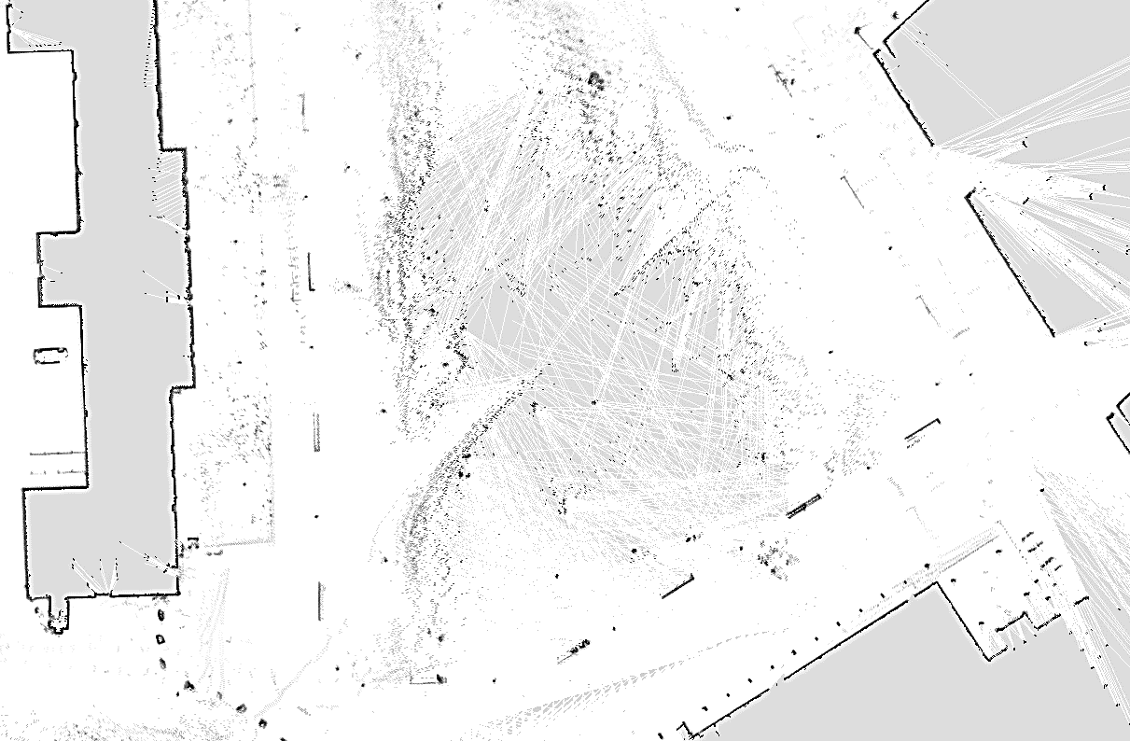
Map
2D occupancy grid map of the Freiburg campus
Black cells are occupied
White cells are unoccupied
Grey cells are unseen
Saved as .yaml and .png files

Slide 9
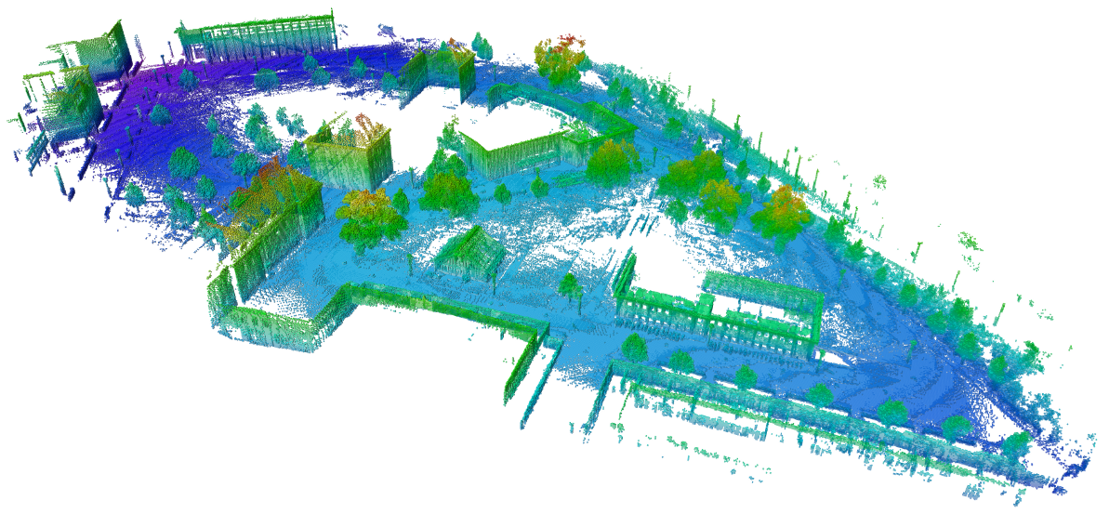
Octomap
Efficient 3D Occupancy Mapping
Octomap

Slide 10
Today

Slide 11
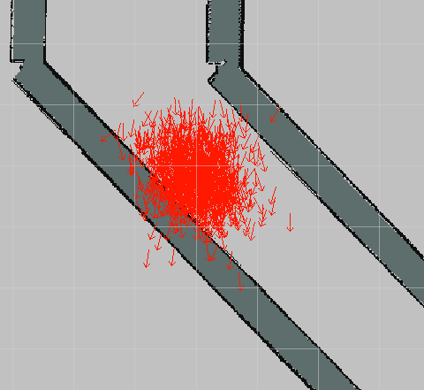
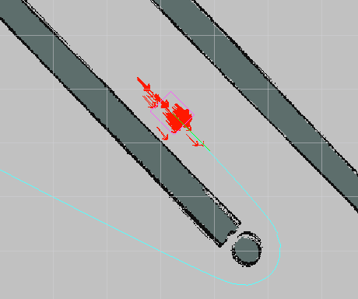
Adaptive Monte Carlo Localization (AMCL)
Algorithm used to locate a robot on a map
It iteratively adapts randomly-sampled points based on odometry and sensor data

Slide 12
Example
https://en.wikipedia.org/wiki/Monte_Carlo_localization#Example_for_1D_robot

Slide 13
AMCL Algorithm
https://en.wikipedia.org/wiki/Monte_Carlo_localization#Overview

Slide 14
Path-Planning
https://en.wikipedia.org/wiki/A*_search_algorithm

Slide 15
Lab Activity 8
Grab a computer, use your own, or partner up!
If you are using your own laptop and haven’t installed Ubuntu or ROS please do so. See the installation guide on the course wiki page or the instructors for help
Follow along with our instructions
WIFI: Westgate-STEM PASSWORD: TheDesignProcess

